Slide 1

AJAX Patterns
Periodic Refresh
Aruna S
Department of
Computer Science and Engineering

Slide 2

AJAX PATTERNS
Periodic Refresh
S. Aruna
Department of Computer Science and Engineering

Slide 3
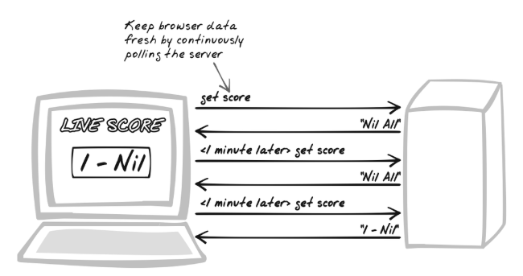
AJAX Patterns
Periodic Refresh
how does application keep users informed of changes occurring on the server?
Auto-Update, Polling, Sychronize, Real-Time
setInterval(callServer, REFRESH_PERIOD_MILLIS);

Slide 4
AJAX Patterns
Fallback Patterns
Objective must be to increase the average refresh period and reduce the content per refresh
Timeout property
Exponential BackOff based on the successful response.

Slide 5
AJAX Patterns
Multi Stage Download Decision factors
How long will the refresh period be?
Three categories of Activity level
Real-Time interaction (milliseconds)
Active monitoring (seconds)
Casual monitoring (minutes)

Slide 6
AJAX Patterns
Periodic Refresh Applications
Online Chat Applications
World headlines
News websites
Score boards
Customized Stock Portal

Slide 7
THANK YOU
Aruna S
Department of
Computer Science and Engineering
arunas@pes.edu

